Slide 1

The Tech Devils
Sprint demo 1

Slide 2
Table of Contents
Project description
deliverables
Communication
Configuration management
Timeline
Risk analysis
Questions

Slide 3
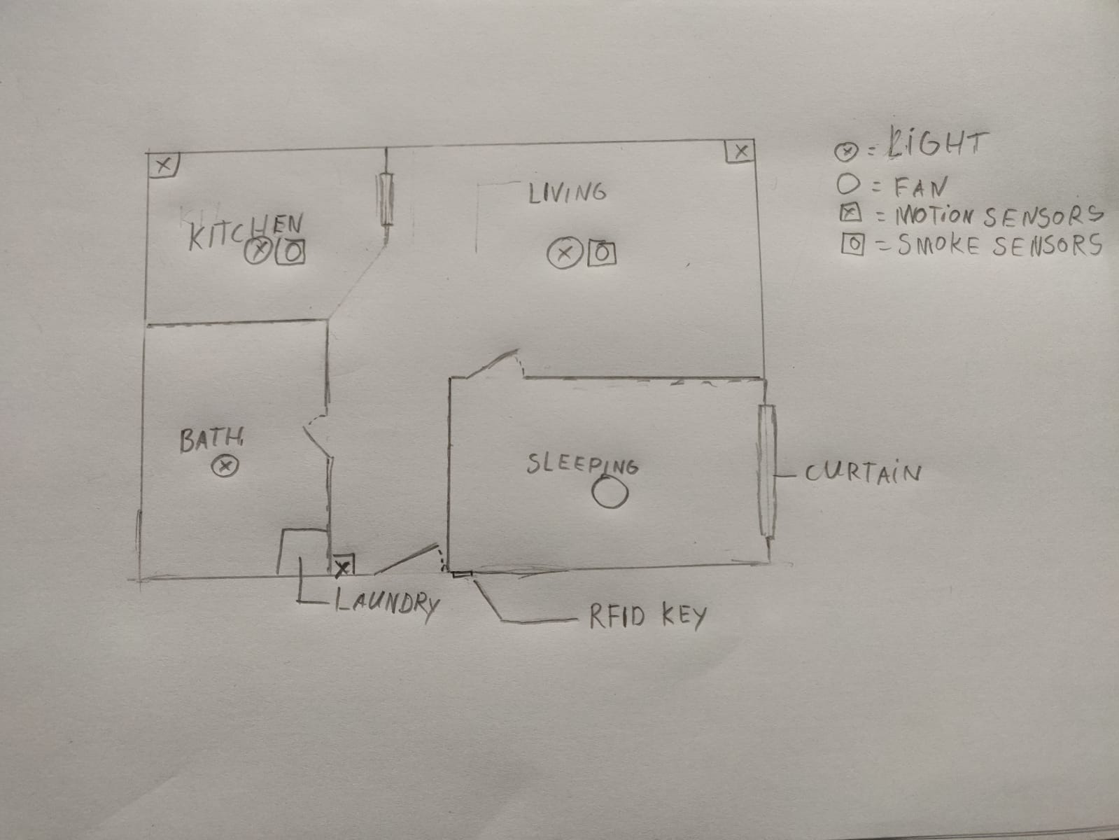
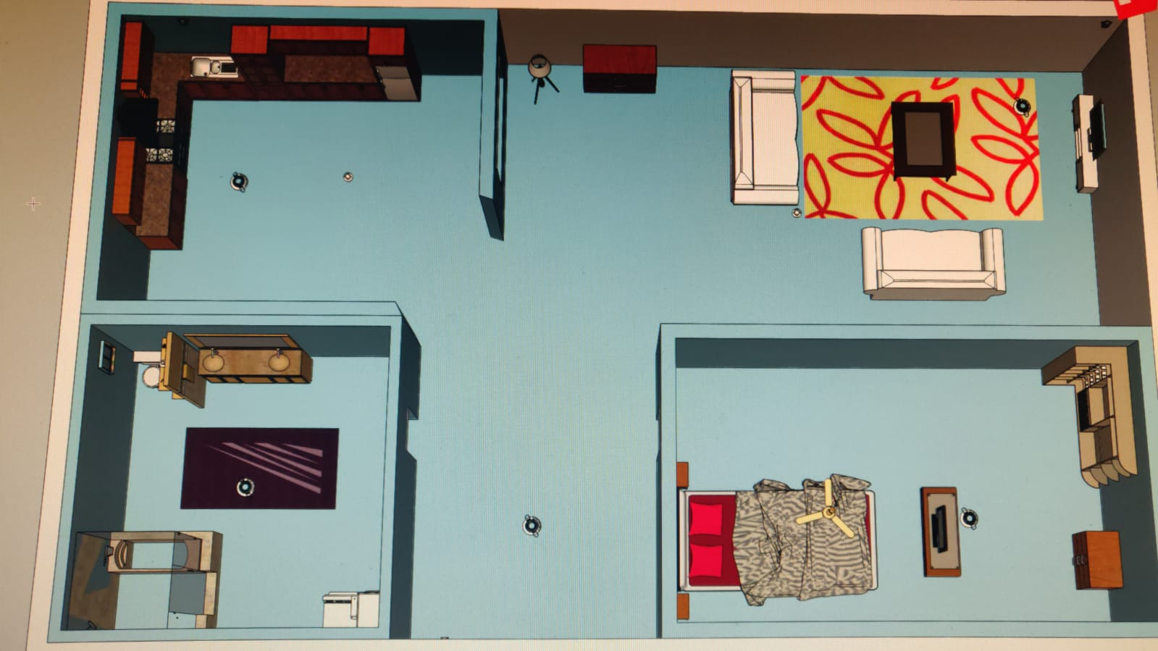
Project Description
The goal of this project is to design a smart student home
Sketch Wireframe

Slide 4
Deliverables
Mandatory
Digital key
Lcd menu
Mood lighting
C# application
Food management
IR sensor
Extra’s
Smoke detector
Full lcd control
Automatic curtains
Room prototype
Full fan control

Slide 5
Communication
Whatsapp and email

Slide 6
Configuration Management
Fhict git
Google drive

Slide 7
Timeline

Slide 8
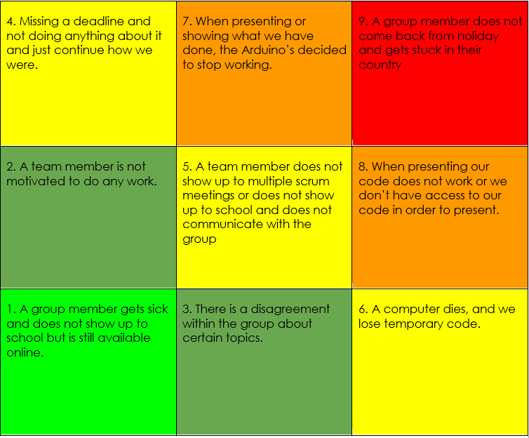
Risk Analysis
Green = Low risk
Yellow = medium risk
Red = high risk

Slide 9
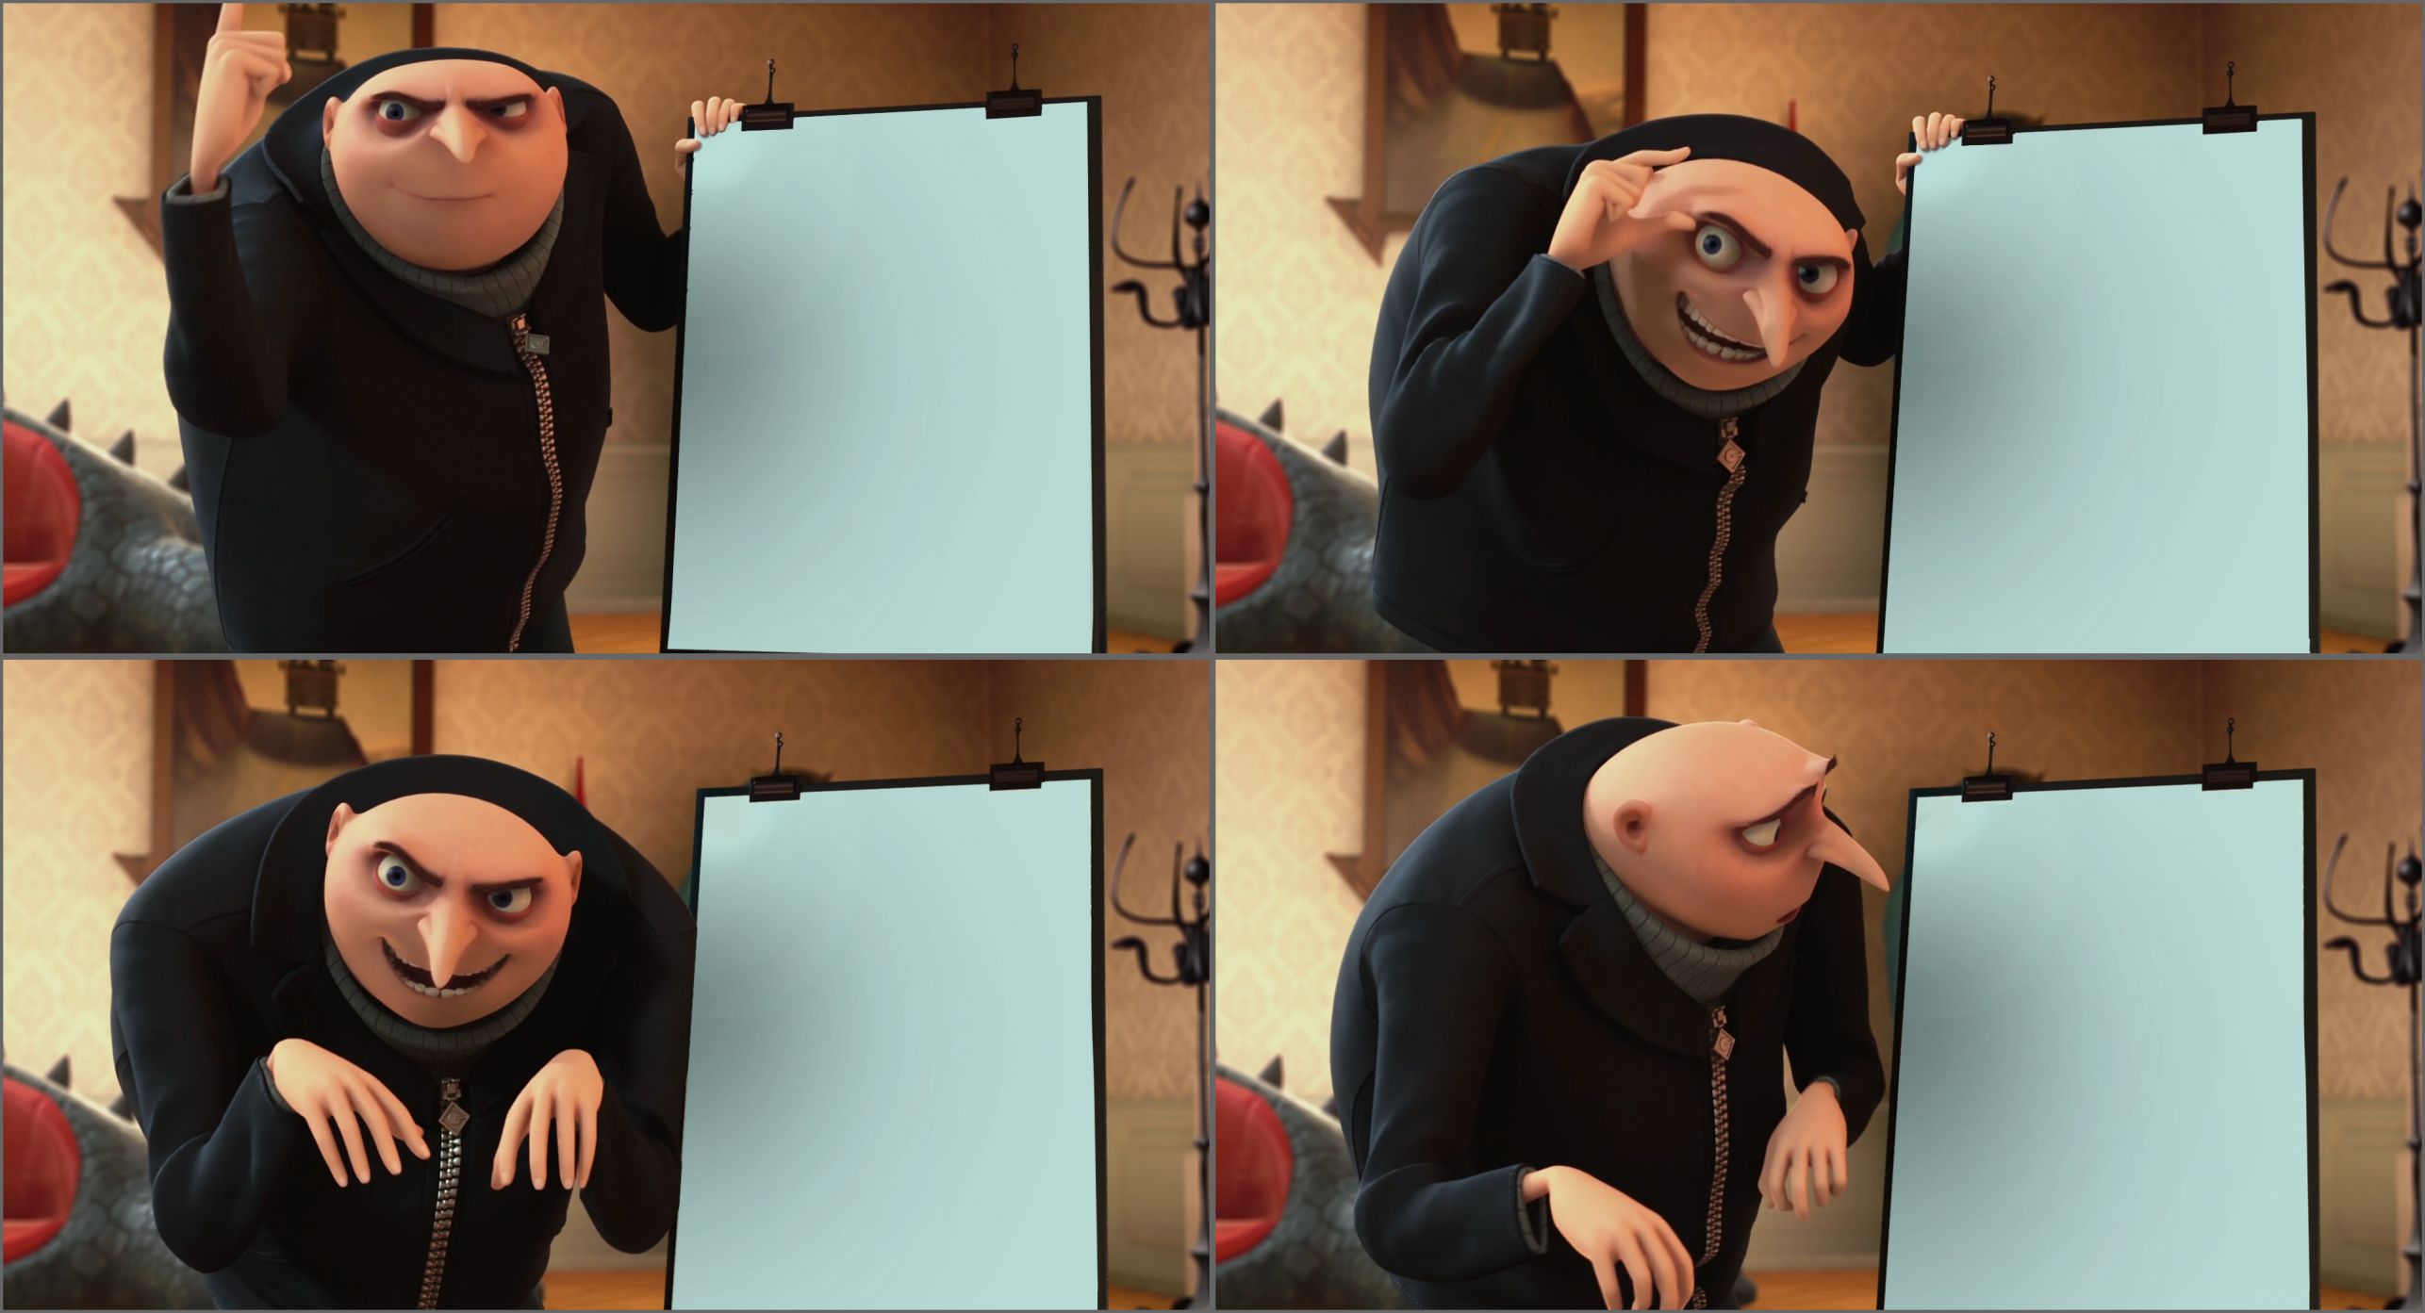
Questions ?

